Slide 1
Soil Erosion

Slide 2
What is Soil Erosion?
Definition: Naturally occurring process that affects all landforms
Agriculture Definition: erosion refers to the wearing away of a field’s topsoil by the natural physical forces of water and wind and the forces associated the farming activities such as tillage.

Slide 3
Types of Erosion
Water Erosion
Wind Erosion
Tillage Erosion
Sheet Erosion
Rill Erosion
Ephemeral Erosion
Gully Erosion

Slide 4
Water Erosion
Soil loss resulting from the action of moving water
Factors Influencing Water Erosion
Excess rainfall
Topography: how the land is arranged by natural and physical features of an area (rolling hills, flat prairie land, deep ravines) and how movement of water flows

Slide 5
Wind Erosion
Soil loss resulting from the action of moving water
Factors Influencing Wind Erosion
Soil Cover: refers to vegetation, including crops, and crop residues on the surface of the soil.
Land Management: process of managing the use and development (in both urban and rural settings) of land resources.
Soil surface type (smooth, rough, covered, exposed)

Slide 6
Tillage Erosion
The redistribution of soil through the action of tillage and gravity.
Types of Tillage
Primary tillage- tillage which inverts, cuts or shatters the soil to a depth of 15-36 cm. Usually leaves the soil rough
Moldboard plows, disk plows, chisel plows, sweep plows, powered rotary tillers, listers/bedders
Secondary Tillage- tillage operations that follow primary tillage. The purpose is to prepare a final seedbed that is suitable for planting, seed germination, and weed control
Disk harrows, field cultivators, powered rotary tillers, roller packers, bed shaping equipment and weed control equipment

Slide 7
Other Types of Erosion
Types of erosion that are effects of water, wind, and tillage erosion
Sheet Erosion—Gradual removal of soil in thin layers by raindrop impact and shallow surface flow. Results in loss of the finest soil particles.
Rill Erosion—Loss of soil in small but visible tracks that are less than 20 cm deep that can be removed by normal cultivation. Develop when surface water concentrates in depressions or low points.
Ephemeral Erosion—small channels eroded by concentrated flow that can be easily filled by normal tillage, only to re-form again in the same location by additional runoff events.
Gully Erosion—Loss of soil in large, often impassible trenches or ditches resulting from runoff. Channels are deeper than 30 cm and cannot be removed by normal cultivation.

Slide 8
Check Point
What are the three main forms of erosion?
What is the difference between rill and gully erosion?
Name two forms of primary and secondary tillage.

Slide 9
Impacts of Erosion on Soil Quality
Wears away top soil which is composed of organic matter
Top soil is the most fertile part of the land with the most nutrients for growing crops, and it takes up to a thousand years to develop one inch of new topsoil.
Organic Matter: consisting of plant and animal residues at various stages of decomposition, cells and tissues of soil organisms, and substances synthesized by soil organisms.
Organic matter is a small fraction (2% to 4%) of soil mainly present on the soil surface.
Organic matter contributes to productivity through its effect on the physical, chemical, and biological properties of the soil.
Erosion gradually depletes organic matter and decreases soil productivity

Slide 10
Soil Management Goals
1.) To sustain and protect soil
2.) Enhance its performance
Working on these goals allow a way for farmers to farm profitably and preserve environmental quality for decades to come.

Slide 11
Ways to Reduce Soil Erosion
Conservation Practices
Contour buffer Strips
Contour Farming
Cover Crops
Crop Rotation
Nutrient Management
Residue Management: No-Till
Field Borders
Grassed Waterways
Terraces
Windbreaks
Bioreactors
Link: https://www.extension.iastate.edu/agdm/crops/html/a1-41.html

Slide 12
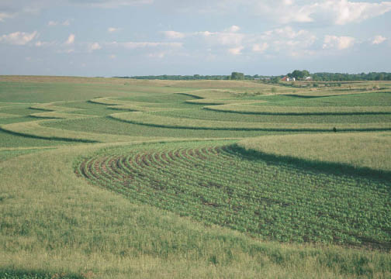
Contour Buffer Strips
Definition: Narrow strips of perennial vegetation established across the slope and alternating down the slope with wider cropped strips
Purpose:
Reduce sheet and rill erosion
Manage runoff water and trap sediment
Provide food and nesting for wildlife
(Duffy, n.d.)

Slide 13
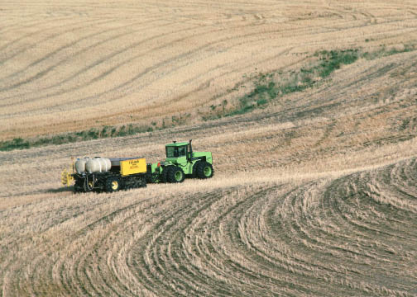
Contour Farming
Definition: Farming sloping land (preparing, planting, and cultivating) on the contour and not up and down the slope.
Purpose:
Reduce sheet and rill erosion
Manage runoff water
Reduce fuel consumption
Used on sloping land
(Duffy, n.d.)

Slide 14
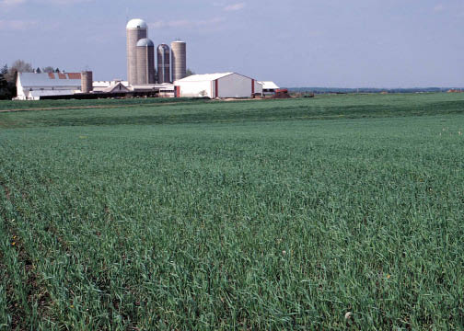
Cover Crops
Definition: A green crop including grasses, cereal grains, legumes or forbs seeded in the early fall to protect the soil surface from erosion and reduce sediment and nutrient loss during the winter months between growing seasons.
Purpose:
Holds soil in place over the winter
Suppresses weeds
Reduces soil erosion
Provides cover to land and topsoil
Reduces nitrate leaching, improve soil health and productivity
Increases soil organic matter content
Controls insects
(Duffy, n.d.)

Slide 15
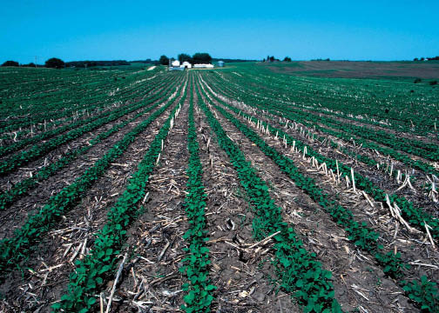
Crop Rotation
Definition: Growing different revenue-generating crops in a repeated sequence on the same field.
Purpose:
Reduce sheet, rill and wind erosion
Maintain or improve soil organic matter content
Manage the balance of plant nutrients
Manage plant pests (weeds, insects and diseases)
Ex: Year 1- Corn, Year 2- Soybeans, Year 3- Corn, Year 4- Alfalfa, Year 5- Corn
(Duffy, n.d.)

Slide 16
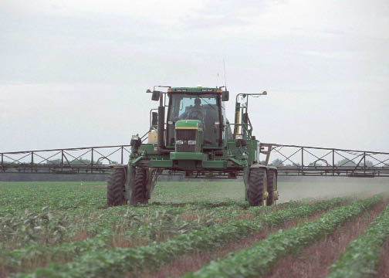
Nutrient Management
Definition: Careful management of the amount, source, placement, form and timing of the application of plant nutrients and soil amendments.
Purpose:
Reduce fertilizer cost (by not over applying)
Protect water quality (by reducing amount of nutrients applied)
Maintain of improve the physical, chemical and biological condition of the soil
(Duffy, n.d.)

Slide 17
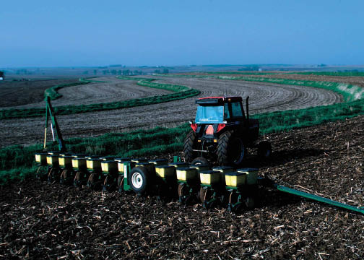
No-till Farming
Definition: Soil and residue is left undisturbed from harvest to planting. Planting, drilling or nutrient application is done in a narrow seedbed or slot created by coulters, row cleaners, or disk openers. No full-width tillage operations are done.
Purpose:
Reduce sheet, rill, and wind erosion
Improves soil organic matter content and soil structure
Increase plant-available moisture
Provide food and habitat cover for wildlife
(Duffy, n.d.)

Slide 18
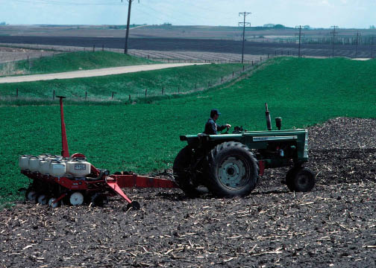
Field Borders
Definition: Strip of perennial vegetation established at the edge or around the perimeter of a field. Used with contour or cross slope farming patterns.
Purpose:
Reduce erosion from wind and water
Protect soil and water quality
Manage pest populations
Provide wildlife food and cover
Improve air quality and increase carbon storage
(Duffy, n.d.)

Slide 19
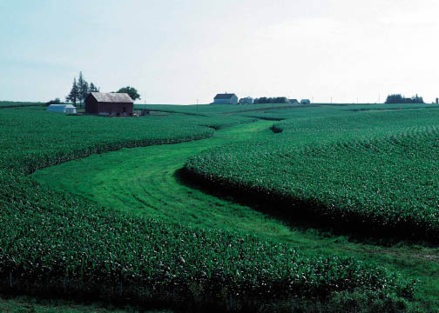
Grassed Waterways
Definition: Areas planted to grass or other permanent vegetative cover where water usually concentrates as it runs off a field.
Purpose:
Slows water and helps guide it off the field
Prevents gully erosion to form
(Duffy, n.d.)

Slide 20
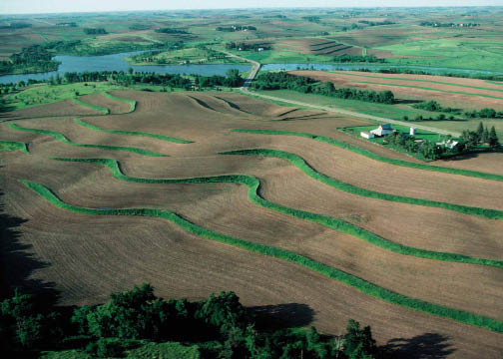
Terraces
Definition: Manmade structures that follow the contour of a hillside, breaking a long slope into smaller segments.
Purpose:
Reduce rate of runoff and allows the soil particles to settle.
Reduces erosion by holding back the water on a field and slowing it down as it moves down the hill.
Used on hillsides and in steep areas of a field
Gives a stair stepped appearance
(Duffy, n.d.)

Slide 21
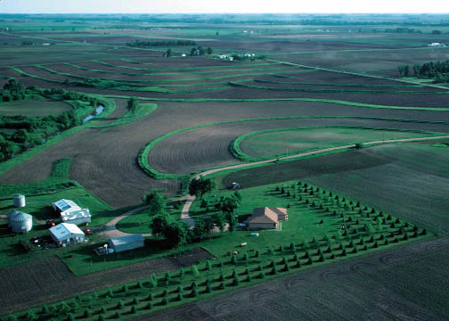
Windbreaks
Definition: Rows of trees and shrubs planted around a farmstead, field or feedlot.
Purpose:
Protects from wind erosion
Acts as a snow fence
Provides wildlife food and cover
Acts as a sound barrier
(Duffy, n.d.)

Slide 22
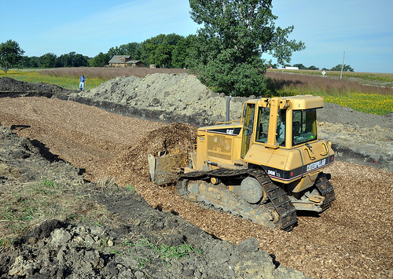
Bioreactors
Definition: An underground trench of woodchips at the end of a tile line. Water from the tile flows through the woodchips before entering a stream or river.
Microorganisms live in the woodchips. These microorganisms “breath” the nitrate-nitrogen from the water. Then they release the nitrogen into the air, making it harmless.
Purpose:
Reduces nitrogen runoff
(Duffy, n.d.)

Slide 23
Check Point
What conservation practice farms/plants on the contour and not up and down the slope?
Explain what no-till farming is and its purpose.
What are the soil management goals?

Slide 24
Questions??

Slide 25
Soil Erosion Activity
We will now put your knowledge to the test!
In this activity we will be observing the effects of water erosion on various soil types. The objective is to identify types of erosion taking place by the force of water and then use the information of different soil conservation practices to create a solution to controlling water-induced topsoil erosion with different soil types.
Your plan needs to be well thought out and then constructed using various materials. You must put an estimation on the cost of the plan and identify where this solution can be used in a practice.

Slide 26
Soil Erosion Activity
Observe the different types of erosion taking place on the stream table.
Identify one or multiple types of erosion taking place and begin to develop a solution for it.
Map out your plan on a piece of paper (include drawing, machinery needed, costs of plan, and where the plan can be most beneficial in a practice. (Please use 2 outside resources for your plan and cite accordingly)
Construct your plan with the provided materials and then test it out on the stream table.

Slide 27
Sources/Resources
Duffy, M. (n.d.). “Conservation practices for landlords.” Iowa State University Extension and Outreach. Retrieved from https://www.extension.iastate.edu/agdm/crops/html/a1-41.html

